Slide 1
Purpose
Sprint ReVIEW: Why We’re here
To review the working product increment, gather stakeholder feedback, and adapt next steps based on what we learn. What Happens ✅ Team demonstrates completed, working functionality ✅ Stakeholders see real progress against the product vision ✅ Open discussion to validate direction and surface feedback What You Get 📌 Clear view of what’s done and usable 📌 Opportunity to influence priorities early 📌 Shared understanding of product status and next steps Outcomes 🔁 Feedback captured 🔁 Product Backlog updated or reprioritized as needed 🔁 Alignment on where the product goes next This is a collaborative working session—not a status report or approval gate.

Slide 2
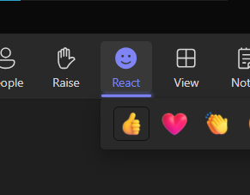
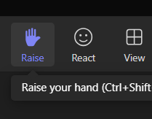
Sprint Review
Need your participation, but how?
You could type on the chat, no magic there.
Use the Reaction if you see something that you is worthy of your interaction but not that much as unmute or type something on the chat. For introverts, might be your choice.
Rise your virtual hand, we will try to put you in queue for talking as soon the spot is open.

Slide 3

Team Everest
Sprint 7 - 2026 Review

Slide 4
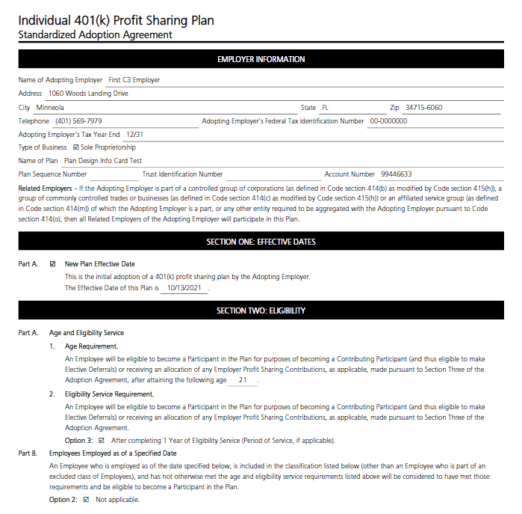
Product Vision
Streamlined, innovative software to ensure the efficient processing and delivery of compliant documents.

Slide 5
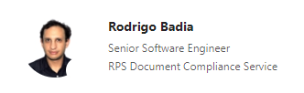
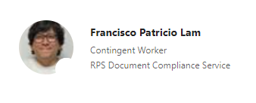




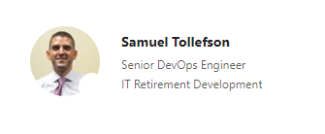

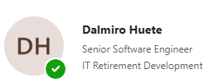
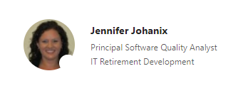
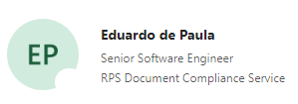





Team Everest Roster

Slide 6
Agenda
1
Sprint Review Survey Feedback
2
Sprint 7 – 2026 Overview
3
Demo
4
Sprint 8 - 2026 Highlights
5
Q2 Planning
6
Initiative Burn-Ups

Slide 7
Sprint Review Survey Summary
Response Rate: 13 of 61 attendees (21%)
Demos are the most valuable part of the Sprint Review
Attendees want earlier, more active business feedback
Big-picture context and the 'why' behind work matters
Opportunities to increase interaction and simplify technical language
Next Steps: targeted questions, clearer visuals, lightweight engagement techniques

Slide 8
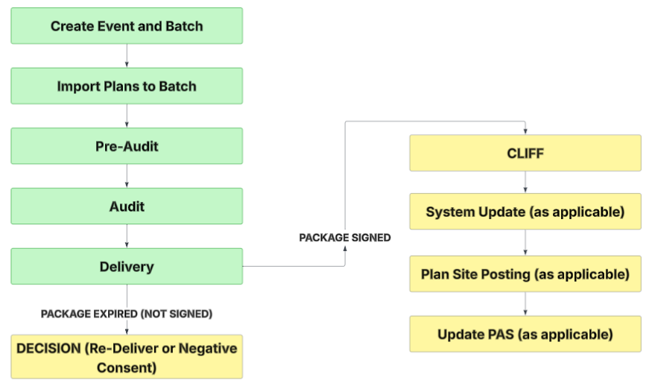
Mass Delivery & Tracking Tool

Slide 9

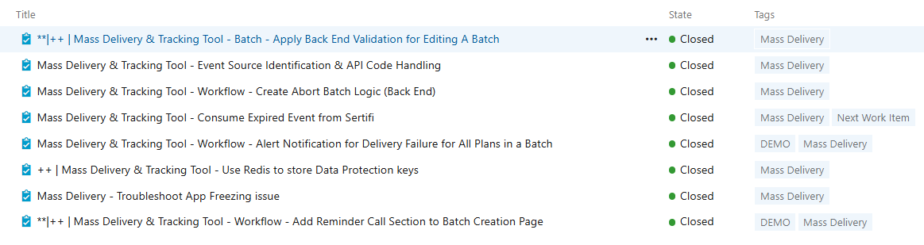
Team Everest Updates – Completed Work
MASS DELIVERY AND TRACKING TOOL
🏢 Internal 👥 Commercial Clients 🤝 External Plan Sponsor

Slide 10
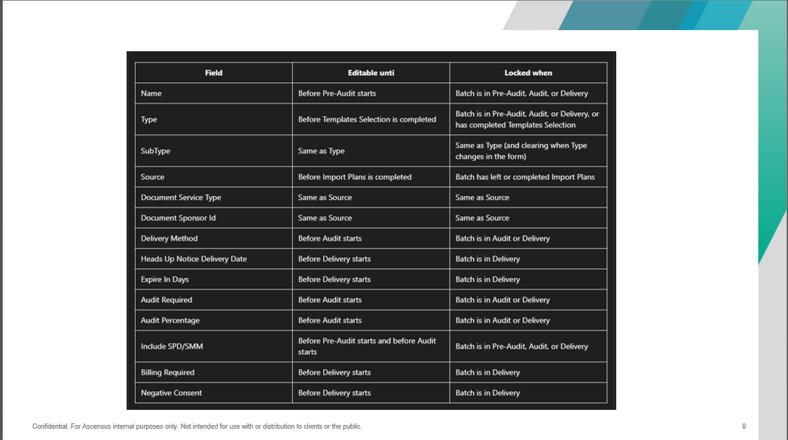
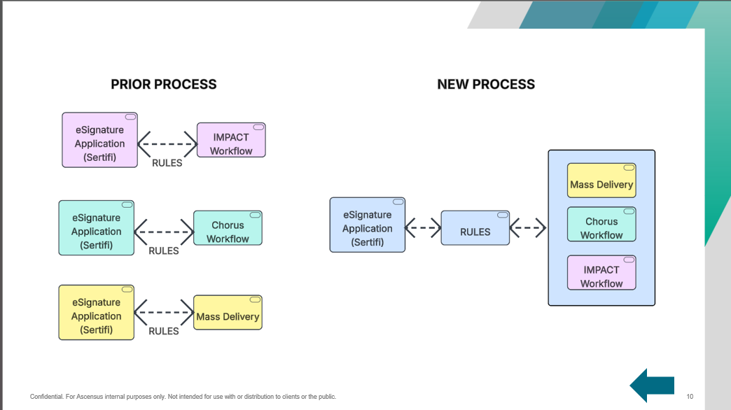
Team Everest Updates – Completed Work Value
MASS DELIVERY AND TRACKING TOOL
Applied business rules to when an internal user is allowed to edit different values previously defined in a batch.
Created a new back-end process to improve how we handle communication between a workflow process and our eSignature solution.
Created the back-end process to allow a user to abort a batch.
Addressed a couple infrastructure issues to add stability and reliability to Mass Delivery.
DEMO
Update Client Package Status when document package becomes expired at Sertifi.
Email Communication Template layout defined for when internal users need to be notified of error/issue.
Allow users to define if and when a reminder call is needed within a BATCH.
🏢 Internal 👥 Commercial Clients 🤝 External Plan Sponsor
Notes:
Problem
Storing encryption keys on a shared network drive caused reliability issues, leading to corrupted keys and user authentication failures in Mass Delivery.
Solution
Move encryption key storage to Redis to improve stability, reliability, and consistent user authentication.

Slide 11
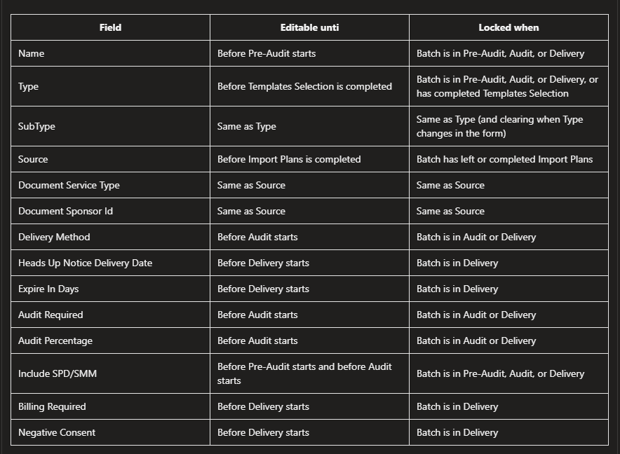

Slide 12
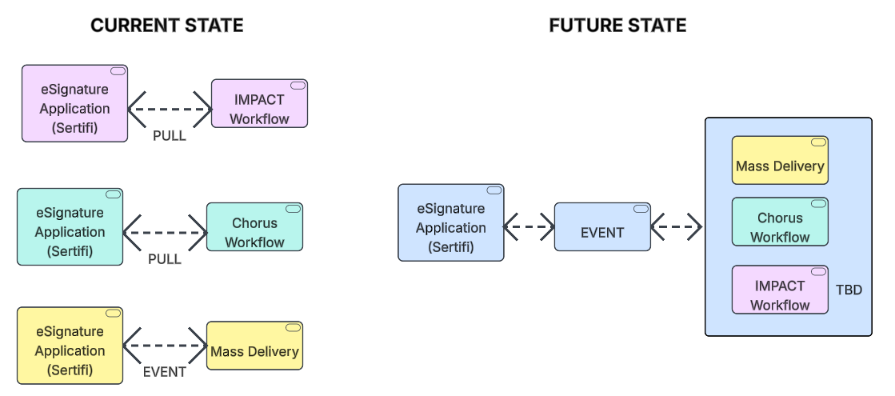
Notes:
Environment agnostic / Application
PULL 4 x per day
Future state, moment we are passed information

Slide 13
Team Everest Updates – Completed Work
INTERIM AMENDMENT
🏢 Internal 👥 Commercial Clients 🤝 External Plan Sponsor

Slide 14
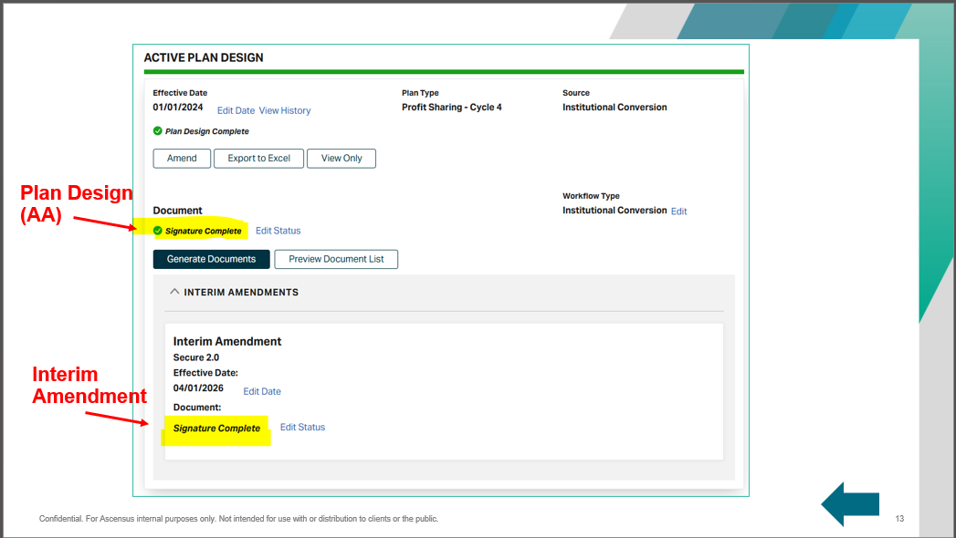
Team Everest Updates – Completed Work Value
INTERIM AMENDMENT
Determined how we will handle interim amendment deliveries when business is leveraging IMPACT as their workflow process.
SOLUTION – TEMPLATE NAME
If Template Name contains the words “Interim Amendment Only” THEN we will only update document status for Interim Amendment
If Template Name contains the words “Includes Interim Amendment” THEN we will update BOTH the document status for the Plan Design (AA) and Interim Amendment
If Template Name contains the words “Excludes Interim Amendment” THEN we will only update document status for the Plan Design (AA)
🏢 Internal 👥 Commercial Clients 🤝 External Plan Sponsor

Slide 15
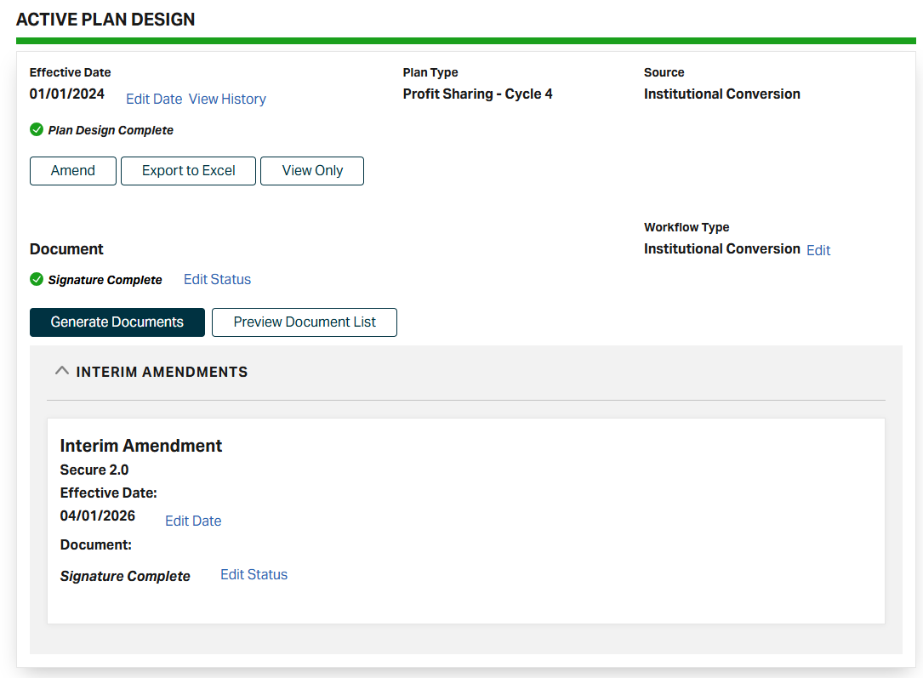




Plan Design (AA)
Interim Amendment
Notes:
Interim Amendment Only
Includes Interim Amendment
Excludes Interim Amendment

Slide 16
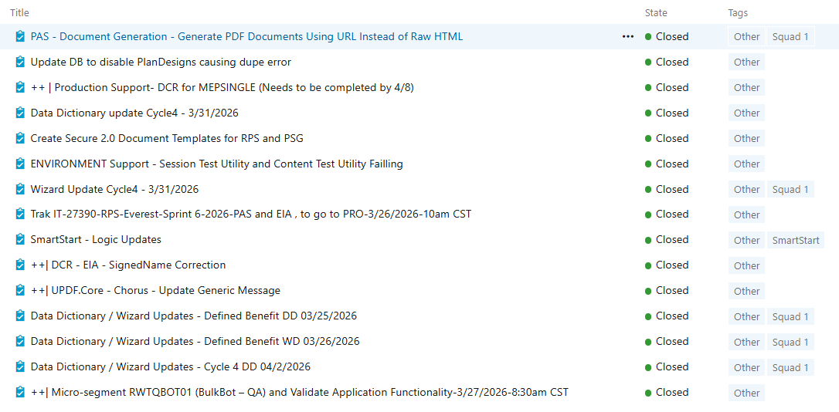
Team Everest Updates – Completed Work
MISCELLANEOUS

Slide 17
Team Everest Updates – Completed Work Value
MISCELLANEOUS
The improved process for generating documents has now been applied to every aspect of PAS in the DEV and QA environment. This will be in production once it has been decided PDF Reactor can roll, waiting on other IT Scrum teams to complete their testing/validation.
Allowed ERISA PAS team to test their SECURE 2.0 wizard changes for all Defined Benefit plan types.
We have 38 Cycle 3 plans and 1 403(b) plan that are considered MEP, updated these plans in Production to note them as such. Allows our internal users to quickly identify a plan as being a MEP plan.
Applied new logic for SmartStart plans for Cycle 3 MEP. Anticipate from business one more update before considered complete. This will allow MEP plans being onboarded to be set up in PAS in an automated process once the first sponsoring entity plan has been created in PAS.

Slide 18
Team Everest Sprint 7 - 2026 Goals
Mass Delivery & Tracking Tool
Create the Expired Package/Document process Done!
Create the Decline to Sign Process (including Chorus workflow) In Process
Load testing for Document Generation (PAS) In Process
Create Abort batch process (back end) Done!
Build process for routing and processing of eSignature Done!
Interim Amendment
Create workflow process for Chorus In Process
Research how to adjust IMPACT workflow to accommodate Interim Amendment without adjusting BPM UX. Done!

Slide 19
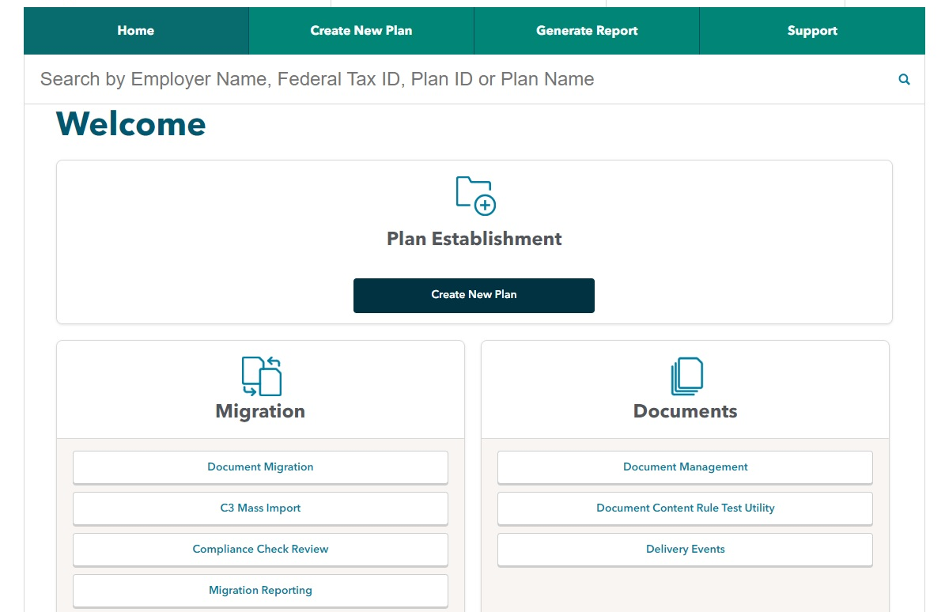
DEMO
Hugo Oliveira
Dalmiro Huete

Slide 20
Sprint 8 - 2026 Highlights
INTERIM AMENDMENT
Always Display "Amend/Edit Interim Amendment" Button
MASS DELIVERY AND TRACKING TOOL
Load Testing Document Package Deliveries to Sertifi
Chorus Workflow for Handling Failed Document Package Delivery
Batch Abort Capability via UI
🏢 Internal 👥 Commercial Clients 🤝 External Plan Sponsor

Slide 21
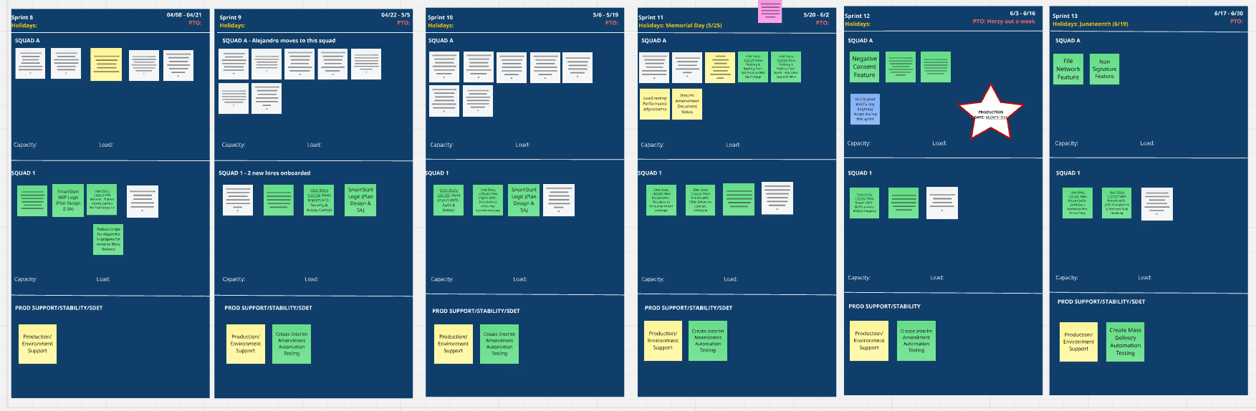
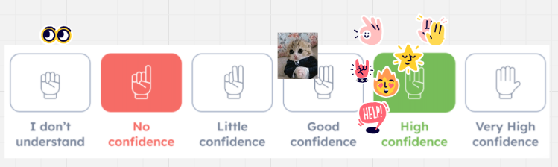
Q2 Team Everest Planning
Notes:
Mass Delivery – on track for “reduced scope” delivery Mid to Late June. Moved team member to this squad.
Interim Amendment – on track for being ready by early May

Slide 22
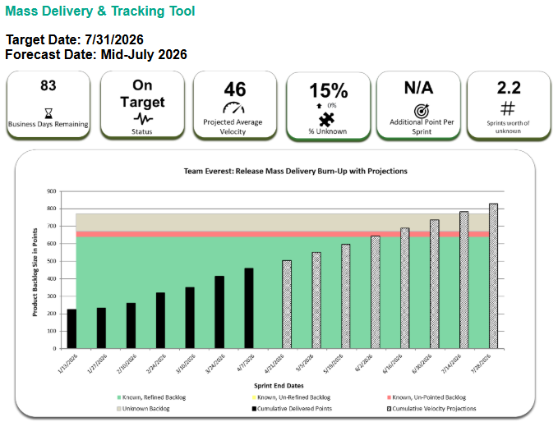

Slide 23
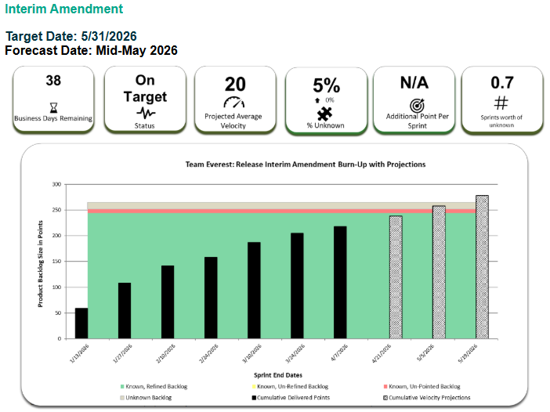

Slide 24
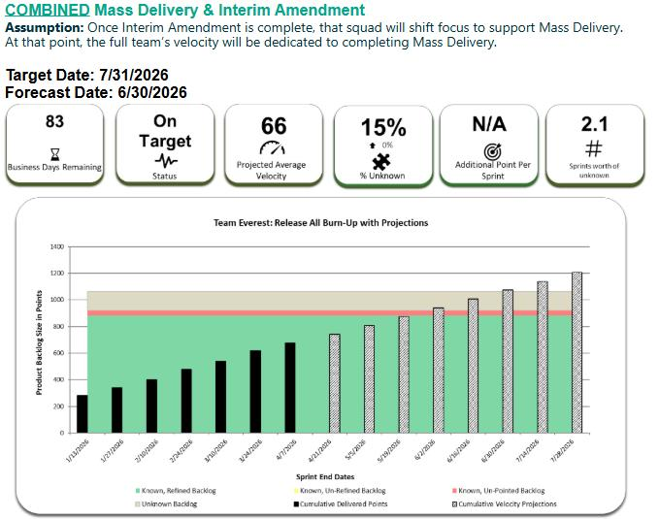

Slide 25
Questions?

